Slide 1

Financial Modeling: Earnings Call and Natural Language Processing Analysis
Presented by Bat Baasan

Slide 2
Goal
To use Natural Language Processing to analyze earning call transcripts and consequent ticker quarter growth to predict performance as compared to respective index.
Source: Daniell Kenneth (GitHub)

Slide 3
What is Earnings call Transcript?
is a conference call between the management of a public company, analysts, investors, and the media to discuss the company’s financial results during a given reporting period, such as a quarter or a fiscal year
Usefulness:
Glean the most current information and data about a company’s revenue, strategic direction, etc., directly from company leadership
See how the company is proactive/ reactive positioning themselves “optics”/ “spin”
Discover what issues analyst are probing via their questions to determine what those in industry think are key to understanding the performance of the company
Source: FPM and NYU guides

Slide 4
Similar analysis
Stock prediction: Using Earnings Call Transcript to Predict Stock Performance (Stanford)
Decision-Making; Modeling Financial Analysts decision making via the pragmatic and semantics of earnings call (Cornell)
Stock market volatility: Volatility Prediction using Earnings Call Transcripts and Rationale behind the Model Prediction (Georgia Tech)
Notes:
Some

Slide 5
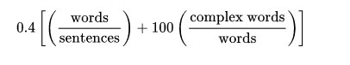
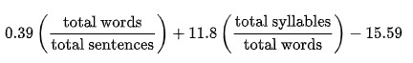
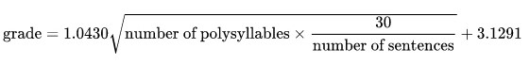
Language Metrics and its math Expression:
Gunning Fog Index:
Felsch- Kincaid Grade Level:
SMOG:

Slide 6
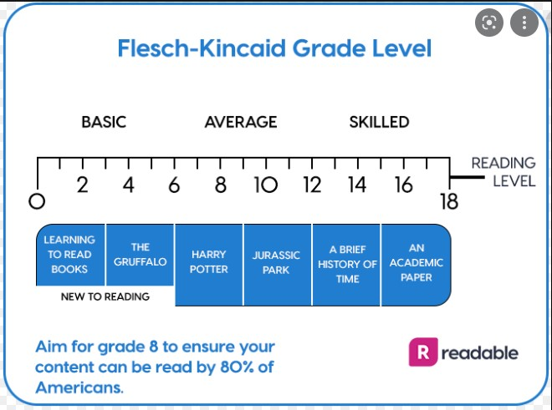
Source: Readable

Slide 7
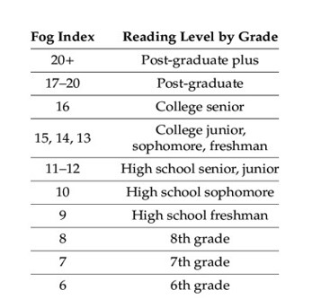
Source: Gunning Fog

Slide 8
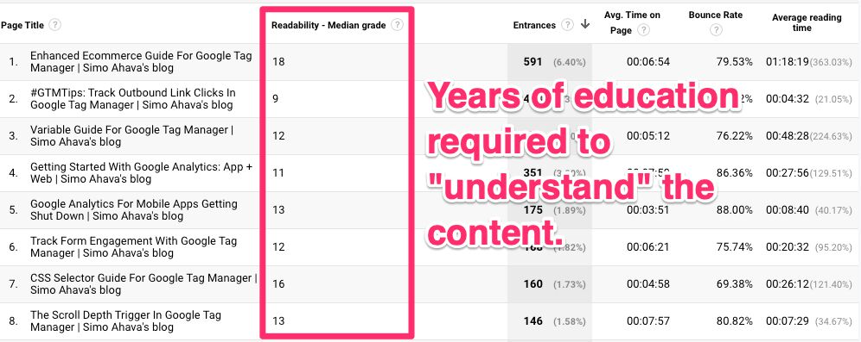
Source: Simo Ahava

Slide 9
Next …
Financial model
ESG model
The financial industry plays an essential part in driving progress on the most pressing
environmental, social, and governance (ESG) challenges of our time.
J.P. Morgan is committed to building a more sustainable and inclusive economy,
from accelerating the transition to a lower-carbon world to bridging
development gaps in emerging countries, to advising on board diversity strategies
and much more. In 2021, the firm set a target to finance and facilitate more than
$2.5 trillion over 10 years, putting these objectives into practice by addressing
climate change and directly contributing to sustainable development

Slide 10
Climate and ESG vs. Investment
Bloomberg ESG and Climate Indices (link)
Green Bond Loans and Social Bond Loan (link)

Slide 11
Thank you
Q&A?

